Slide 1
CS6370 NLP
Course Project
- Naveen Vakada (CS20S012)
- Arup Das (CS20S016)

Slide 2
Limitations of the current search engine
Fails to classify documents containing synonymous words or documents with the same context as relevant documents.
The title of the document was not used.
Does not consider the co-occurrence relation between the terms in similar documents.

Slide 3
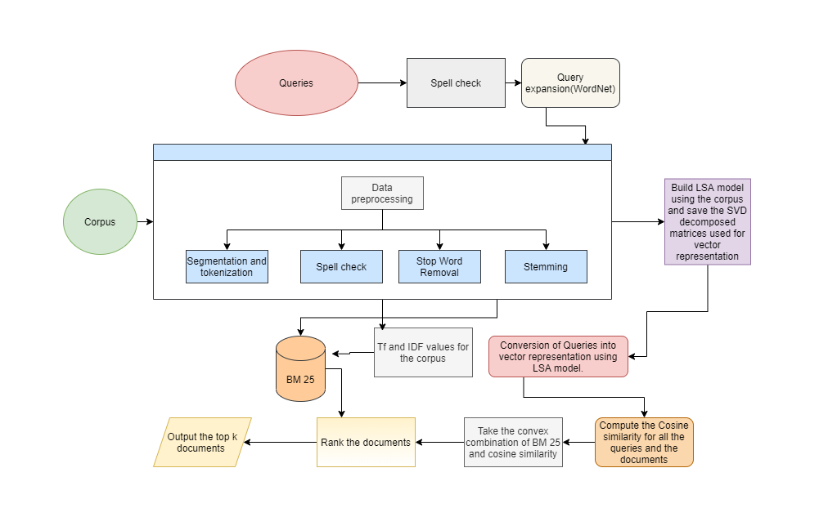
Proposed methodology

Slide 4

Completed tasks
Implemented BM25
Used titles of the document to improve the performance.
Completed reading about how to implement LSA in python.

Slide 5
Pending Work
Implementing LSA
Implementing Statistical hypothesis testing to compare the mean nDCG of the old method and the new proposed method.
Implementing query expansion.
Implementing Spell Check.

